Slide 1
Recreating Prussin 2019 results
By: Harmon Bhasin

Slide 2
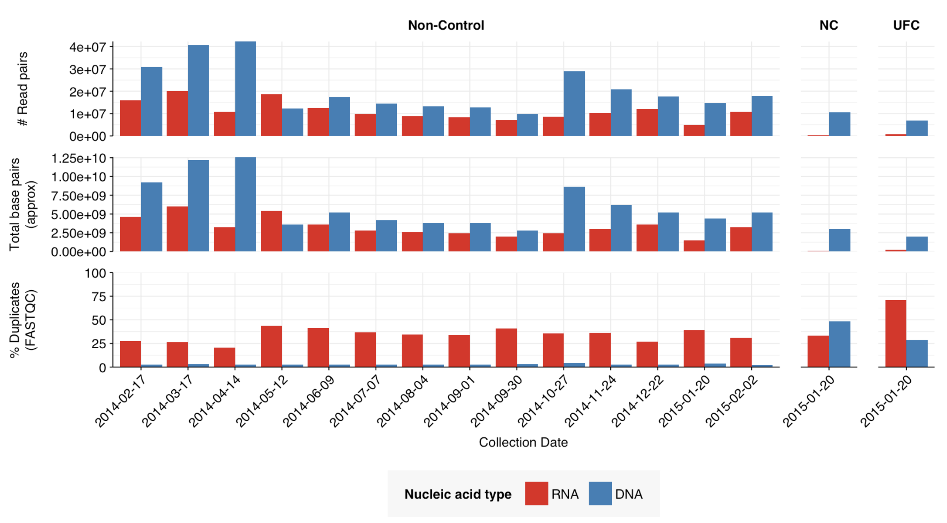
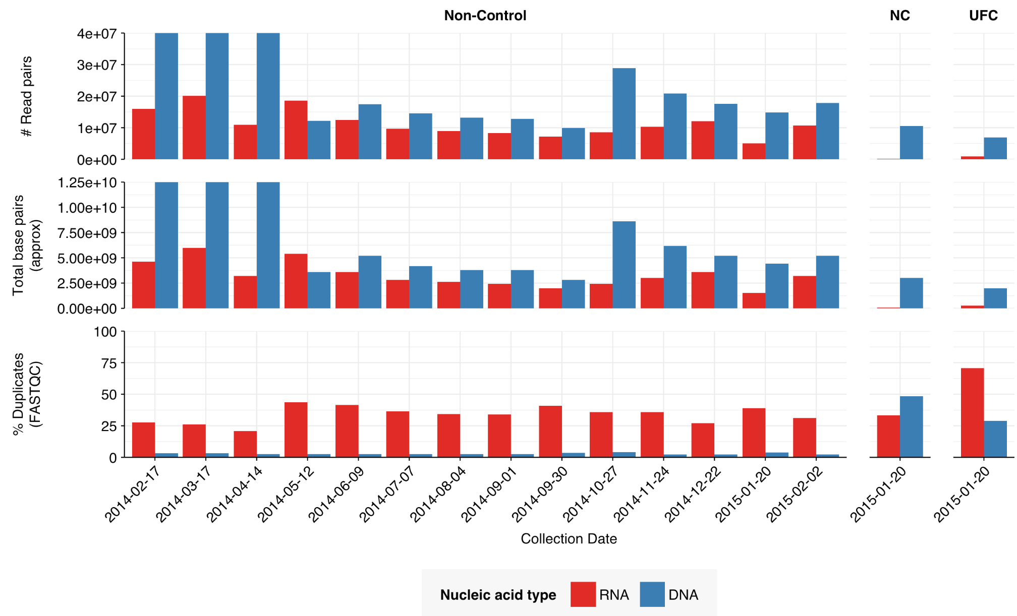
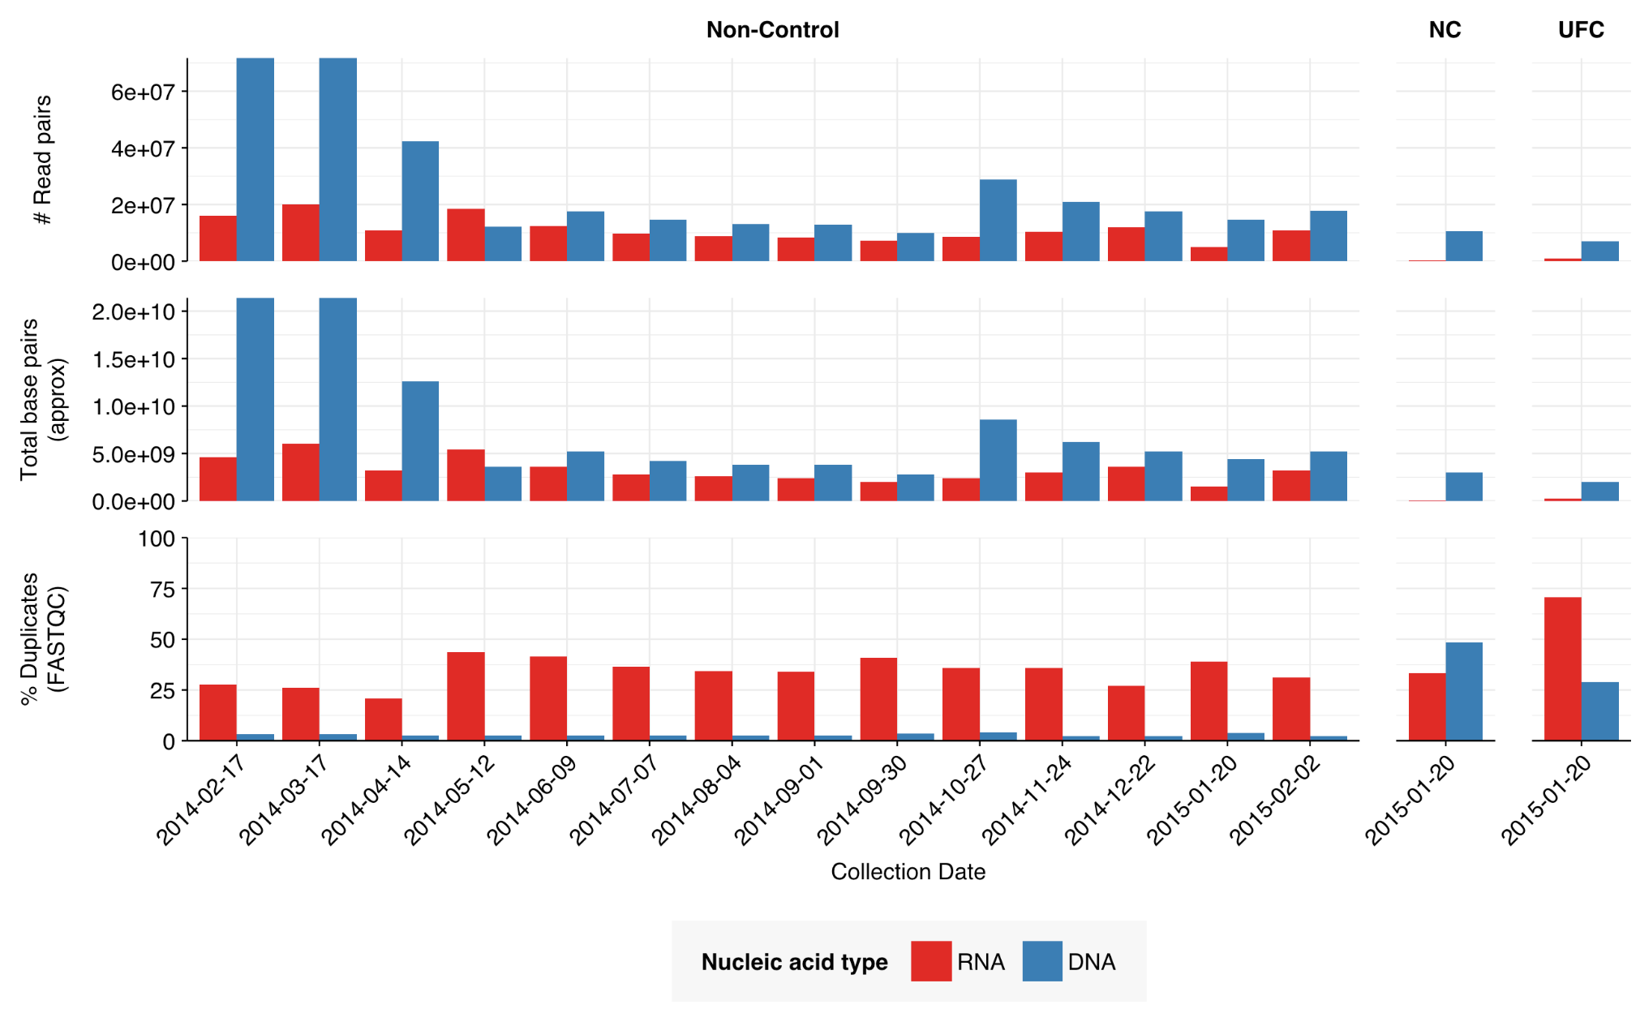
Differences b/w Will’s & Harmon’s Analysis For Prussin 2019
Everything looks same, except two of the DNA samples which have significantly more reads (highlighted in red)
If I put an upper bound on the values to try and recreate Will’s plot, we can see that everything looks the same excluding the first two samples.
I ended up writing a script to download the data onto the server so it was most likely an error by me.
Will’s Analysis
Harmon’s Analysis
(w/ upper bound)
Harmon’s Analysis

Slide 3
Tracing samples with excessive reads
Two dates correspond to the following samples:
2014-02-17 = AP-DNA-1 (SRR8663616)
3.6 GiB SRR8663616_1.fastq.gz
3.8 GiB SRR8663616_2.fastq.gz
2014-03-17 = AP-DNA-3 (SRR8663615)
3.7 GiB SRR8663615_1.fastq.gz
3.9 GiB SRR8663615_2.fastq.gz
Found the issue: when downloading the accession list, the author had the metadata wrong so there was two AP-DNA-1 instead of an AP-DNA-1 and AP-DNA-2
Explains why sample 1 and 2 look exactly the same for DNA

